Slide 1
Giacomo Cappon
Shared Preferences
Notes:
This lesson will be easier and lighter with respect to the others because I want to you to fix in your mind the concepts we learned so far.

Slide 2
Outline
Persist key-value data
shared_preferences
Counter app with persistence
Exercise
Homework
Resources

Slide 3
Persist key-value data
Today we will start to understand how to implement persistence: as such, it will be possible to “save” things on the disk and “resume” the state of the application when it is restarted
The simplest type of persistence (and commonly used by many applications)? Storing primitive (String, bool, int, float, List<String>) key-value data. Some examples:
“id” : 3
“user” : ”mario”
“isAdmin” : false
…
key : value

Slide 4
Persist key-value data
Some use cases of key-value data persistence:
Remember the preferences of a certain user
App theme
App “general” parameters
Restore previous session status
Was the user logged in during the last session?
Decide which screen to visualize when the app restarts
How to implement key-value data persistence
Fortunately, in Flutter implementing this functionality is very easy thanks to the shared_preferences package
https://pub.dev/packages/shared_preferences
key : value

Slide 5
Outline
Persist key-value data
shared_preferences
Counter app with persistence
Exercise
Homework
Resources

Slide 6
shared_preferences
shared_preferences encloses a singleton of class SharedPreferences that can be accessed via the getInstance() asynchronous static method: final sp = await SharedPreferences.getInstance();
What is a “singleton”?
Singleton is a design pattern (1 of the 23) of object-oriented programming that guarantees that for a given class, only one instance of that class can be created.
This means that only one instance of the SharedPreferences will be present in our app. So, in practice, the getInstance() method will return always the same object.

Slide 7
shared_preferences – write
Here’s the methods of shared_preferences to write data:
// Save an integer value to 'counter' key.
await sp.setInt('counter', 10);
// Save an boolean value to 'repeat' key.
await sp.setBool('repeat', true);
// Save an double value to 'decimal' key.
await sp.setDouble('decimal', 1.5);
// Save an String value to 'action' key.
await sp.setString('action', 'Start');
// Save an list of strings to 'items' key.
await sp.setStringList('items', <String>['Earth', 'Moon', 'Sun']);

Slide 8
shared_preferences – read
Here’s the methods of shared_preferences to read data:
// Try reading data from the 'counter' key. If it doesn't exist, returns null.
final int? counter = sp.getInt('counter');
// Try reading data from the 'repeat' key. If it doesn't exist, returns null.
final bool? repeat = sp.getBool('repeat');
// Try reading data from the 'decimal' key. If it doesn't exist, returns null.
final double? decimal = sp.getDouble('decimal');
// Try reading data from the 'action' key. If it doesn't exist, returns null.
final String? action = sp.getString('action');
// Try reading data from the 'items' key. If it doesn't exist, returns null.
final List<String>? items = sp.getStringList('items');

Slide 9
Outline
Persist key-value data
shared_preferences
Counter app with persistence
Exercise
Homework
Resources

Slide 10
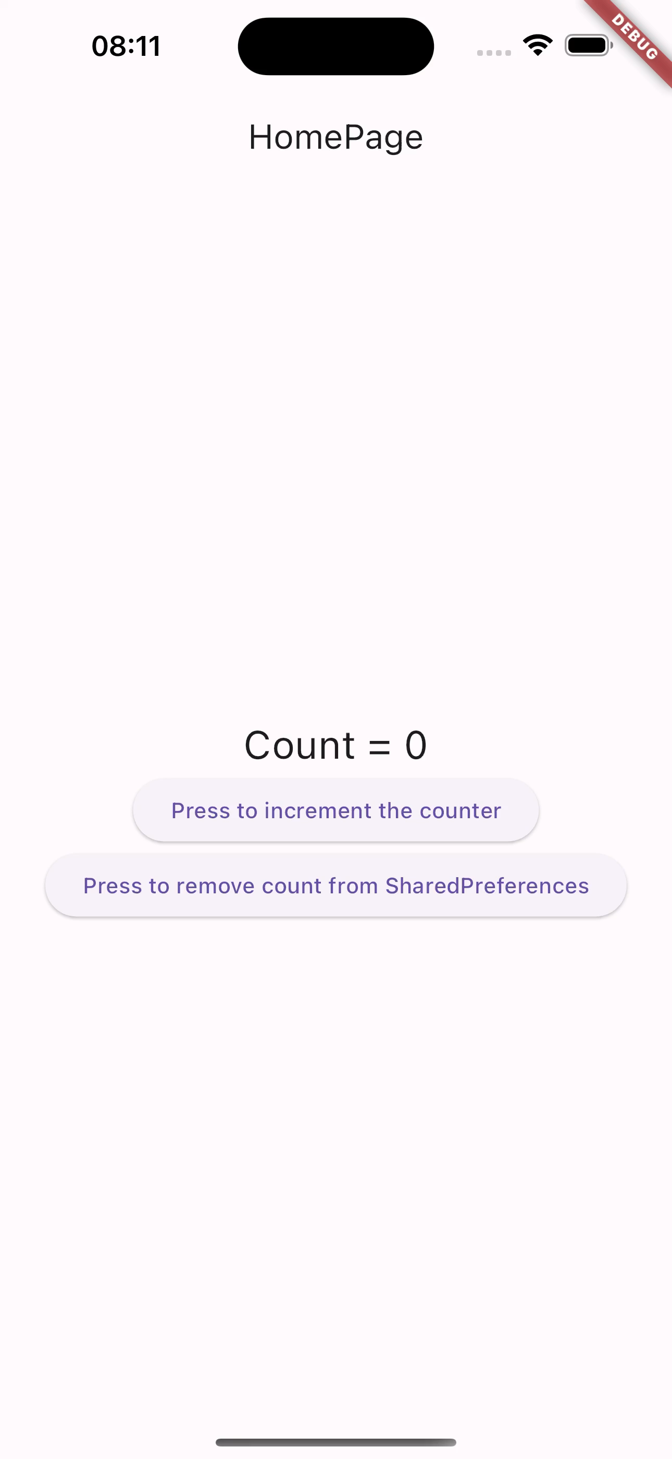
Counter app with persistence
As a case of study, today we will implement a simple app called “counter” that persists an integer to offer the following functionalities:
If a user tap a button, an integer counter (starting from 0) is incremented by 1 and the result is displayed by a Text widget. The new value of the counter is then persisted using shared_preferences
If the user restarts the app, the app “resumes” the value of the counter by loading it from the disk
If another button is tapped, the integer is removed from SharedPreferences. So, if the app is restarted, the counter will start back from 0.
Full example in lab_08-shared_preferences/counter/
Notes:
Step 0: Create the app and the structure (only homepage)
Step 1: Refactor HomePage to a Stateful widget and create its state: the counter integer
Step 2: Create UI and “link” the counter into Text widget
Step 3: Implement increment logic
Step 4: Implement initState logic
Step 5: Implement remove counter logic

Slide 11
Outline
Recap
Persist key-value data
shared_preferences
Counter app with persistence
Exercise
Homework
Resources

Slide 12
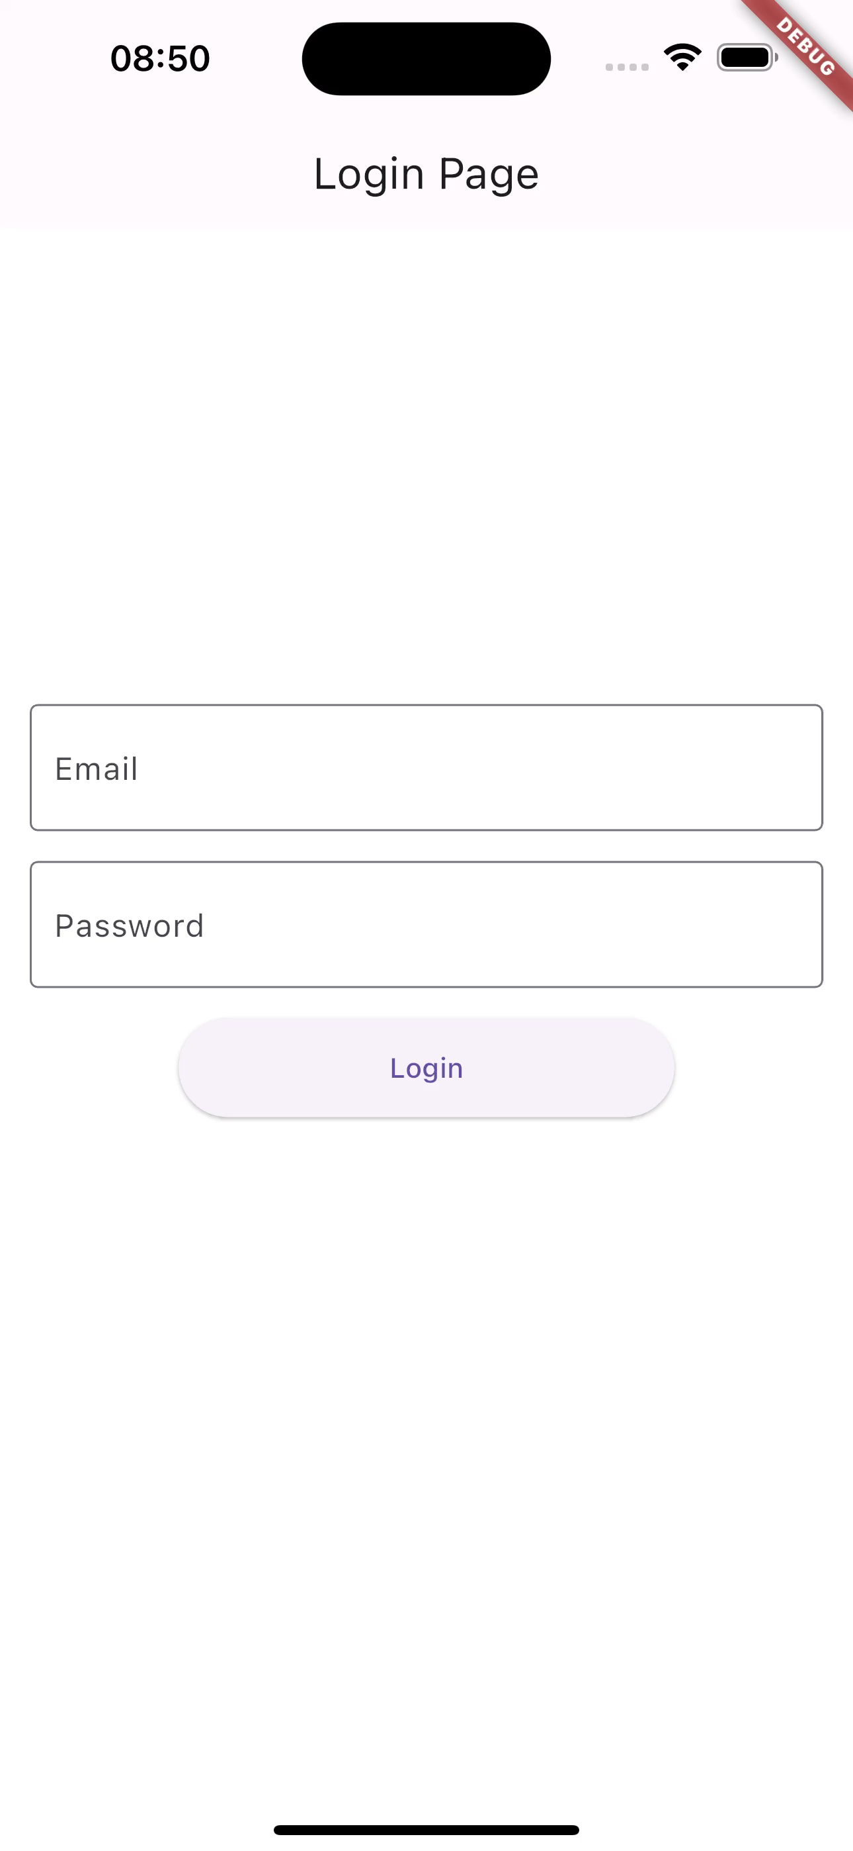
Exercise
Exercise 08.01 (easy-medium)
Start from the code of Exercise 06.02 (the login_flow app)
Right now, every time you restart the app, the LoginPage is showed to user
Use the shared_preferences package to change this behaviour and let the app “remember” the last user session. As such:
If a user opens the app for the first time, the LoginPage route is showed;
If the user logs in, the HomePage is showed;
If a user restarts the app and he/she did not log out in the last session, the HomePage is showed;
If a user restarts the app and he/she logged out in the last session, the LoginPage is showed.

Slide 13
Outline
Persist key-value data
shared_preferences
Counter app with persistence
Exercise
Homework
Resources

Slide 14
Homework
Get familiar with shared_preferences
Take look to a safer alternative: flutter_secure_storage
https://pub.dev/packages/flutter_secure_storage

Slide 15
Outline
Recap
Persist key-value data
shared_preferences
Counter app with persistence
Exercise
Homework
Resources

Slide 16
Resources
shared_preferences package
https://pub.dev/packages/shared_preferences
Flutter community cookbook on SharedPreferences
https://docs.flutter.dev/cookbook/persistence/key-value

